Slide 1
Chapter 15
Operating System Security

Slide 2
System Access Treats
Intruders (hacker or cracker) - the most common threats other than viruses
Malicious software (malware) - programs that exploit vulnerabilities in computing systems

Slide 3
System Access Treats
Intruders categories
Masquerader: An individual (mostly outsider) who is not authorised to use the computer and who penetrates a system’s access controls to exploit a legitimate user’s account
Misfeasor: A legitimate user (insider) who accesses data, programs, or resources for which such access is not authorised, or who is authorised for such access but misuses the privileges

Slide 4
System Access Treats
Intruders categories
Clandestine user: An individual (outsider / insider) who seizes supervisory control of the system and uses this control to evade auditing and access controls or to suppress audit collection

Slide 5
System Access Treats
Malicious categories
Parasitic (requires host program)
Fragments of programs that cannot exist independently of some actual application program, utility, or system program. Examples are viruses, logic bombs, and backdoors
Independent
Self-contained programs that can be scheduled and run by the OS. Examples are worms and bot programs

Slide 6
Countermeasures
Intrusion detection - a security service that monitors and analyses system events to find and provide real-time or near real-time warning of unauthorised access attempts.

Slide 7
Countermeasures
2 classifications of Intrusion Detection Systems(IDS):
host-based IDS - monitors the characteristics of a single host and the events occurring within that host for suspicious activity
network-based IDS - monitors network traffic for particular network segments or devices and analyses network, transport, and application protocols to identify suspicious activity

Slide 8
Countermeasures
IDS components:
Sensors
Collect data.
Input: any part of a system that could contain evidence of an intrusion, such as network packets, log files, and system call traces.
Forward information to the analyser

Slide 9
Countermeasures
IDS components:
Analysers
Determine if an intrusion has occurred
Input: from sensor(s) or other analyser(s)
Output: indication of an intrusion, may include evidence
May provide guidance about what actions to take as a result of the intrusion

Slide 10
Countermeasures
IDS components:
User interface
Enables a user to view output from the system or control the behaviour of the system.
May equate to a manager, director, or console component.

Slide 11
Authentication
Fundamental building block and the primary line of defence
Consists of two steps:
Identification step
presenting an identifier to the security system
Verification step
presenting or generating authentication information that corroborates the binding between the entity and the identifier

Slide 12
Means of Authentication
Something the individual knows, include a password, a personal identification number (PIN), or answers to a prearranged set of questions
Something the individual possesses (known as token) such as electronic keycards, smart cards, and physical keys

Slide 13
Means of Authentication
Something the individual is (static biometrics), such as recognition by fingerprint, retina, and face
Something the individual does (dynamic biometrics), examples include recognition by voice pattern, handwriting characteristics, and typing rhythm

Slide 14
Access Control
Implements a security policy that specifies who or what may have access to each specific system resource and the type of access that is permitted in each instance
Mediates between user and system resources, such as applications, operating systems, firewalls, routers, files, and databases

Slide 15
Access Control
Security administrator maintains an authorisation database that specifies what type of access to which resources is allowed for each user
the access control function consults this database to determine whether to grant access
An auditing function monitors and keeps a record of user accesses to system resources

Slide 16
Firewall
Goals:
Acts as a choke point, all incoming / outgoing traffic must pass through the firewall
Enforces the local security policy, which defines the traffic that is authorized to pass
Secure against attacks
Protect systems from network-based security threats while affording access to the outside world via wide area networks (WAN) and the Internet

Slide 17
File System Access Control
Identifies a user to the system
Each user is associated with a profile that specifies permissible operations and file accesses
The OS enforces rules based on the user profile
The database management system must control access to specific records or even portions of records

Slide 18
File System Access Control
The database management system decision for access depends on the user’s identity and also on the specific parts of the data being accessed and even on the information already divulged to the user
A general model of access control exercised by a file or database management system is access matrix

Slide 19
Access Matrix
Elements in access matrix:
Subject: An entity capable of accessing objects. Generally, subject equates with that of process. Any user or application actually gains access to an object by means of a process that represents that user or application

Slide 20
Access Matrix
Elements in access matrix:
Object: Anything to which access is controlled, such as files, portions of files, programs, segments of memory, and software objects (e.g., Java objects)
Access right: The way in which an object is accessed by a subject. Examples are read, write, execute, and functions in software objects.

Slide 21
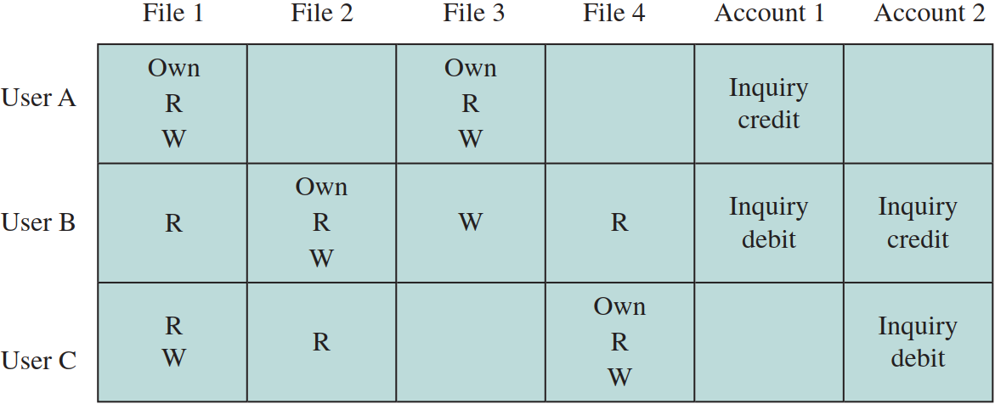
Access Matrix

Slide 22
Access Matrix
In practice, access matrix is usually sparse and is implemented by decomposition
by columns - access control lists
For each object, access control list lists users and their permitted access rights.
May contain a default, or public entry: allows users that are not listed as having special rights to have a default set of rights.
Elements of the list may include individual users and groups of users.

Slide 23
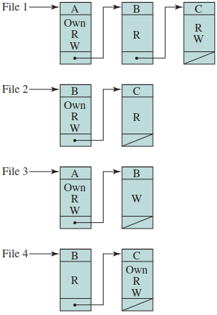
Access Matrix (Access Control Lists)

Slide 24
Access Matrix
In practice, access matrix is usually sparse and is implemented by decomposition
by rows - capability tickets
Specifies authorised objects and operations for an user.
Each user has a number of tickets and may be authorised to loan or give them to others - tickets may be dispersed around the system, present a greater security problem.
Ticket must be unforgeable, accomplished by having the OS hold all tickets on behalf of users.

Slide 25
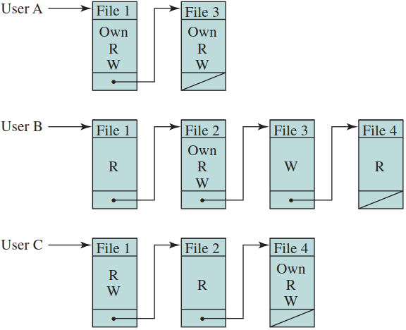
Access Matrix (Capability Tickets)

Slide 26
Operating Systems Hardening
Basic steps to use to secure an operating system:
Install and patch the operating system
Harden and configure the OS to adequately address the identified security needs of the system by:
removing unnecessary services, applications, and protocols
configuring users, groups and permissions
configuring resource controls

Slide 27
Operating Systems Hardening
Basic steps to use to secure an operating system:
Install and configure additional security controls, such as antivirus, host-based firewalls, and intrusion detection systems (IDS)
Test the security of the basic OS to ensure that the steps taken adequately address its security needs

